Slide 1
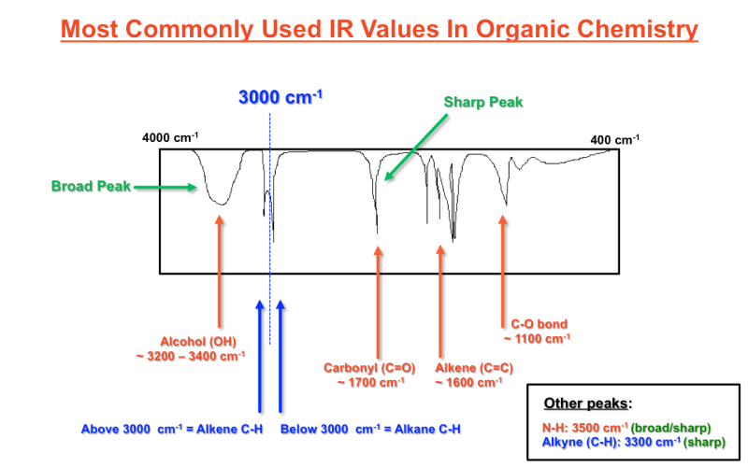
How molecules vibrate (AKA “normal modes of vibration”)
Stretching
Stretching and bending
Symmetric stretch, bend, and asymmetric stretch. (There’s another bending mode where the atoms move in and out of the plane of the screen here.)

Slide 2

How molecules vibrate (AKA “normal modes of vibration”)
Stretching
Stretching and bending
=> We need to take account of vibrational contributions to $U(T,V)$.
Symmetric stretch, bend, and asymmetric stretch. (There’s another bending mode where the atoms move in and out of the plane of the screen here.)

Slide 3

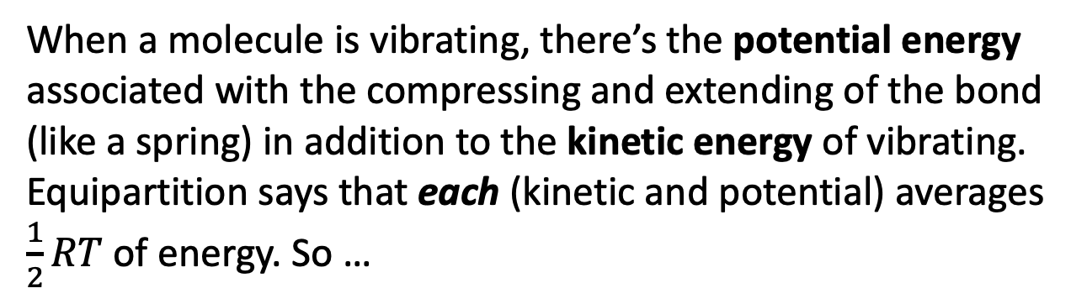

The vibrational contribution to $U(T,V)$
When a molecule is vibrating, there’s the potential energy associated with the compressing and extending of the bond (like a spring) in addition to the kinetic energy of vibrating. Equipartition says that each (kinetic and potential) averages $\frac{1}{2}RT$ of energy. So …
$U_{vib}\left(T,V\right)=$ $\frac{1}{2}RT+\frac{1}{2}RT=\frac{2}{2}RT$
$$C_{V,vib}=\frac{2}{2}R$$
When a molecule is vibrating
When a molecule can’t vibrate, there’s no contribution to to $U$ or $C_{V}$:
$U_{vib}\left(T,V\right)=$ $0$
$$C_{V,vib}=0$$
When a molecule isn’t vibrating

Slide 4

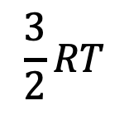


Why would a molecule vibrate, or not vibrate? Quantum energy discretization
$$\frac{3}{2}RT$$
$$I_{2}$$
$$F_{2}$$
$$H_{2}$$
At low temperature, only $I_{2}$ can vibrate. $F_{2}$ or $H_{2}$ can’t.

Slide 5
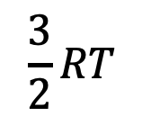
Why do molecules vibrate at high temperature, but not at low temperature?
$$\frac{3}{2}RT$$
$$I_{2}$$
$$F_{2}$$
$$H_{2}$$
Warmer, so $I_{2}$ and $F_{2}$ can vibrate, but $H_{2}$ can’t.

Slide 6
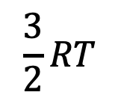
Why do molecules vibrate at high temperature, but not at low temperature?
$$\frac{3}{2}RT$$
$$I_{2}$$
$$F_{2}$$
$$H_{2}$$
Even hotter, so all three molecules can vibrate.

Slide 7
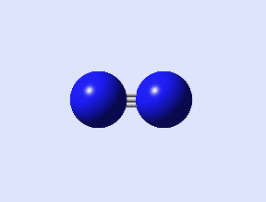
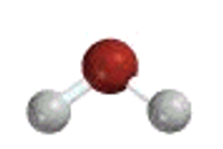


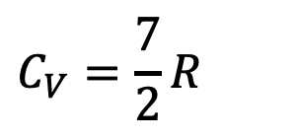


A low-temperature (non-vibrating) regime, and a high-temperature (vibrating) regime
$$C_{V}=\frac{5}{2}R$$
$$C_{V}=\frac{7}{2}R$$
Low-temperature regime
High-temperature regime
The high-temperature, vibrating regime is also called the classical regime
$$C_{V}=\frac{12}{2}R$$
High-temperature regime
$$C_{V}=\frac{6}{2}R$$
$$C_{V}=\frac{13}{2}R$$
Low-temperature regime
High-temperature regime

Slide 8

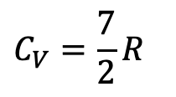





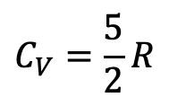
$T^{∗}$ defines the transition from the low- to high-temperature vibrational regime of a molecule
$$U(T,V)$$
$\frac{7}{2}R$
$$slope=\frac{5}{2}R$$
not vibrating
vibrating
$$C_{V}=\frac{5}{2}R$$
$$C_{V}=\frac{7}{2}R$$
$$C_{V}(T,V)$$
$\frac{7}{2}R$
$$\frac{5}{2}R$$
T
T*
High-T (classical) regime
Low-T regime

Slide 9
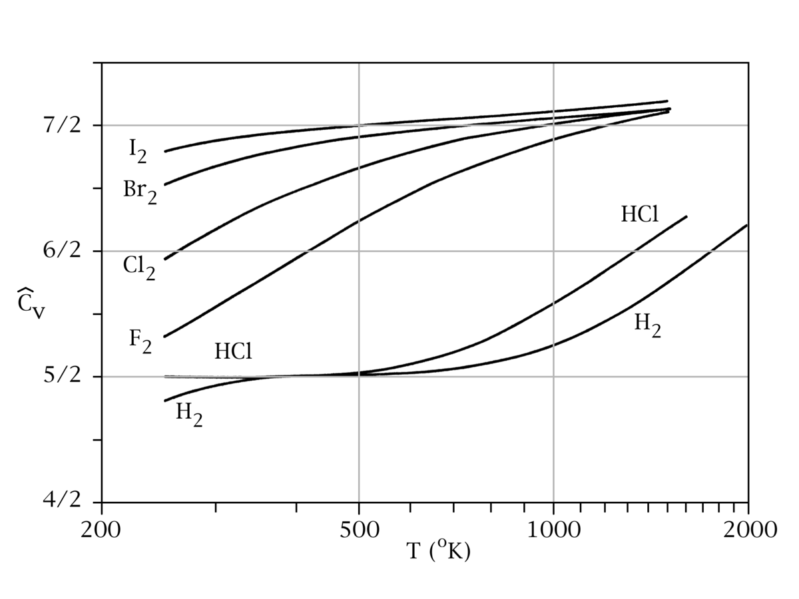

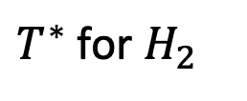
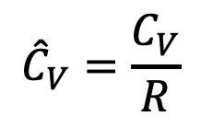
You can see this happening in measured heat capacities – here’s $H_{2}(g)$
Here, ${\hat{C}}_{V}=\frac{C_{V}}{R}$ (one mole).
$${\hat{C}}_{V}=\frac{C_{V}}{R}$$
$T^{∗}$ for $H_{2}$

Slide 10

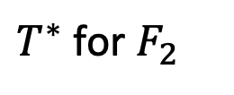
And here’s $F_{2}(g)$
Here, ${\hat{C}}_{V}=\frac{C_{V}}{R}$ (one mole).
$${\hat{C}}_{V}=\frac{C_{V}}{R}$$
$T^{∗}$ for $F_{2}$

Slide 11
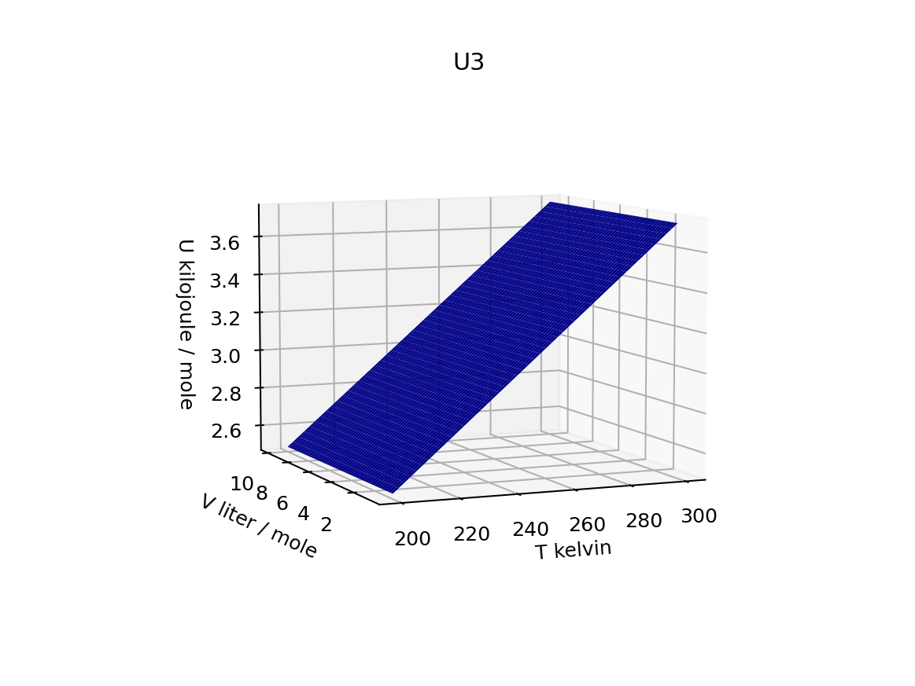
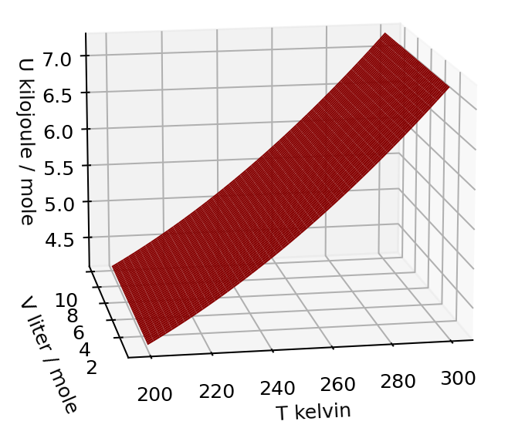
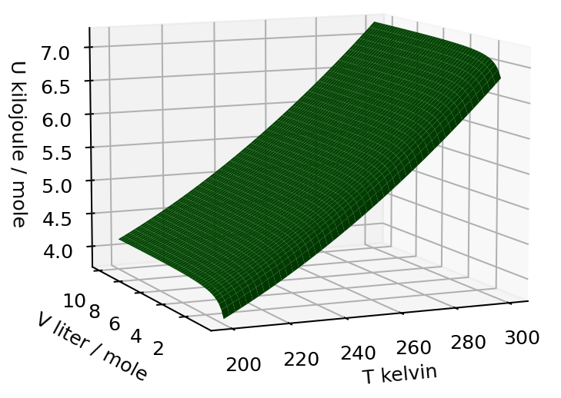
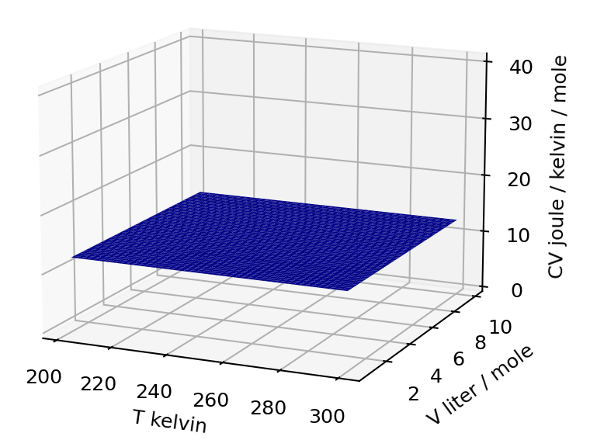
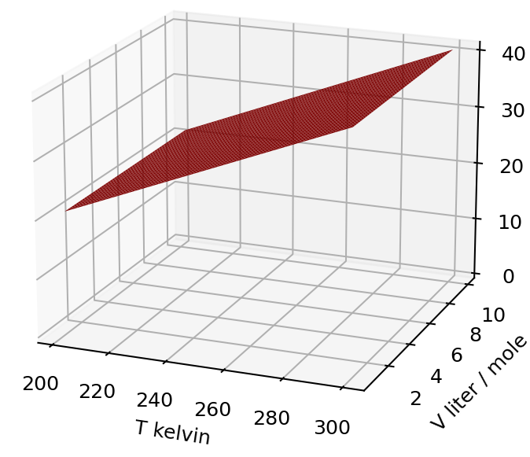
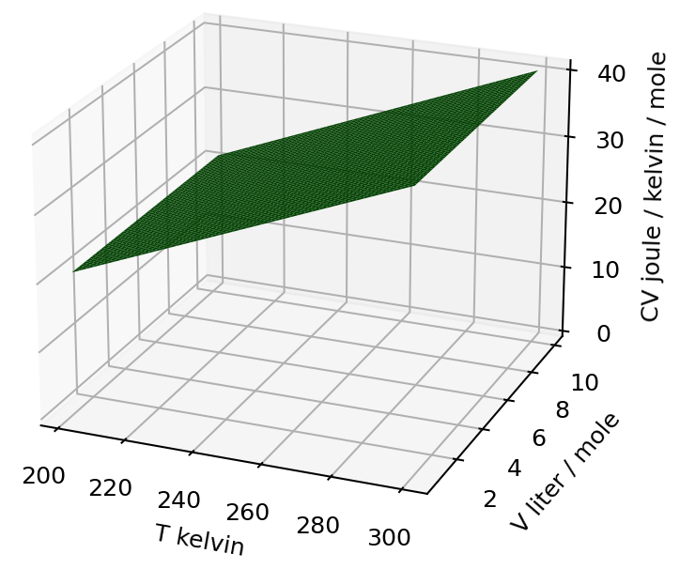


Bottom line: if $C_{V}\left(T,V\right)$ is T-independent => it’s an atomic gas, otherwise it’s a polyatomic gas
$$U(T,V)$$
$$C_{V}(T,V)$$
Constant slope in the temperature direction
Increasing slope in the temperature direction

